Slide 1
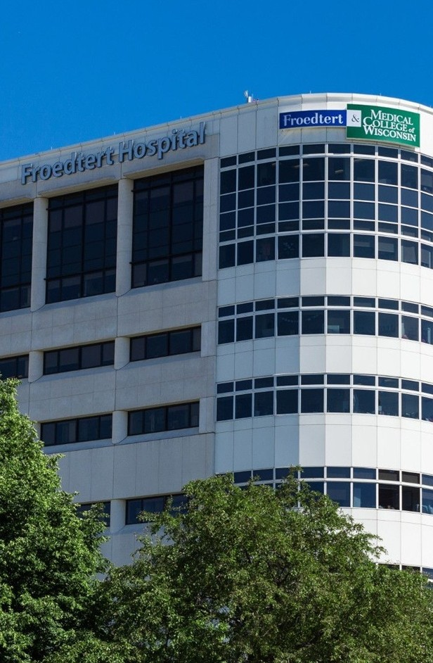


Direct-to-Employer
Go-to-Market Strategy
OPPORTUNITY REVIEW | NOVEMBER 2026
Exploring a Froedtert ThedaCare Health direct-to-employer health plan for self-funded employers in eastern Wisconsin and northern Illinois
Prepared for

Slide 2



A branded health plan built for Froedtert ThedaCare
EXECUTIVE SUMMARY
A large, reachable market
Steerage that moves share
Claims paid, not denied
4,400+ employers with 900,000+ employees are headquartered in the Froedtert ThedaCare service area, from Milwaukee to the Fox Valley and Green Bay.
Froedtert ThedaCare holds an estimated 23% inpatient share today. KBA DTE networks average 83% Tier 1 steerage; we model 67% inpatient by Year 4.
In a comparable KBA DTE program, fewer than 3 in every 1,000 claims were denied or held for information in 2025.
$17.1M
Projected Year 4 net margin change for Froedtert ThedaCare
Target case: 10,900 members, 67% inpatient and 58% outpatient steerage, 30.4% commercial margin

Slide 3
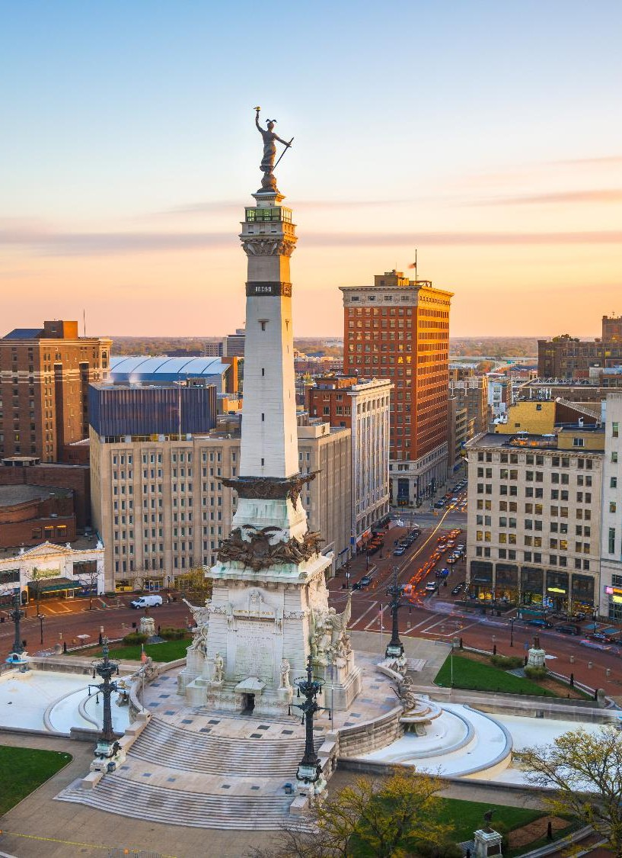
A national leader in self-funded plans
ABOUT KEY BENEFIT ADMINISTRATORS
1979
3,000+
Founded in Indianapolis
Corporate clients
3M
700
Members under management
Employees
Largest independently owned full-service third-party administrator
Specialists in self-funded plan administration and population health management
A leader in the direct-to-employer movement
Works with every professional team: agents, networks and MGAs
The Key Family of Companies is a vertically integrated group of benefit organizations

Slide 4
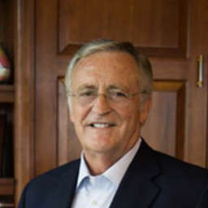
46 years of striving for honesty in healthcare
OUR FOUNDING AND HERITAGE
1979
1985
1992
Today
Founded KBA
Partnered with BCBS
Reacquired KBA
Largest independent TPA
After co-founding a life insurance agency in 1973 and Key Life Insurance in 1976, Larry Dust launched KBA as a TPA focused on honest healthcare delivery.
Sold to Blue Cross Blue Shield of Indiana, gaining capital and market access while keeping operational independence.
Larry bought the business back, returning it to full independence and a patient-focused mission.
KBA is the country's largest independently owned TPA, managing millions of members across diverse markets.
Larry Dust
Founder, Key Benefit Administrators
Never forgotten who gives healthcare
KBA has never participated in reference-based pricing, does not take refunds, and delivers healthcare at 11% below market rates. Our commitment remains with providers and patients, not profit extraction.

Slide 5
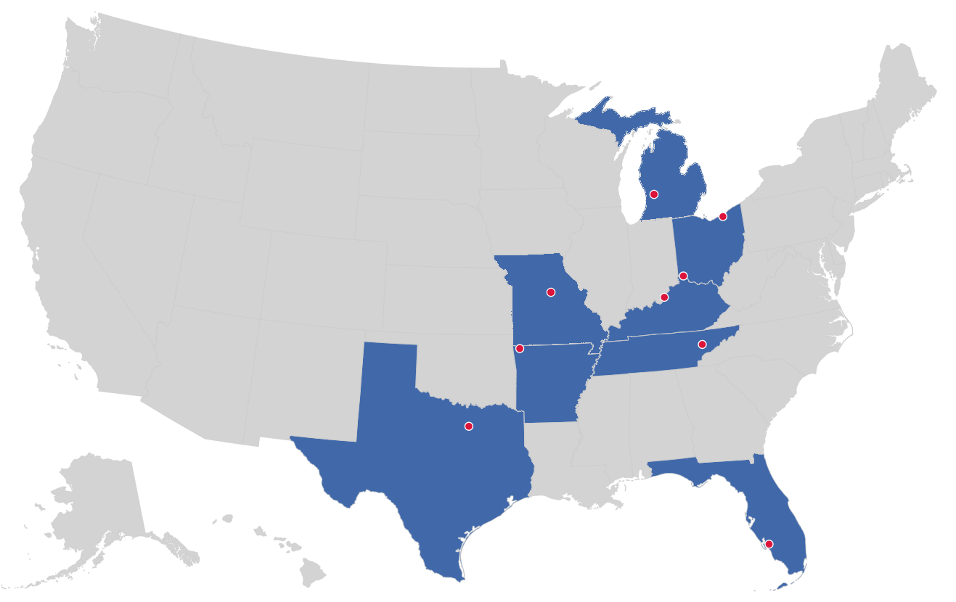

Market leader in private-labeled DTE plans
TRACK RECORD
Private-labeled DTE markets
Cleveland, OH
Cincinnati, OH
Grand Rapids, MI
Columbia, MO
Louisville, KY
Knoxville, TN
Bentonville, AR
Dallas-Fort Worth, TX
Fort Myers, FL
Nine private-labeled DTE markets

Slide 6



Fewer than 3 in 1,000 claims denied or held
2025 CLAIMS EXPERIENCE
2025 denial experience, comparable KBA DTE program (% of claims processed)
HOW IS THIS POSSIBLE?
0.27%
0.02%
0.29%
The low denial rate is by design.
Full denials
Full LOIs (lack of information)
Combined denials and LOIs
Plan designs customized for each DTE partner
Share of claims denied
No heavy-handed pre-certification or prior authorization used to deny claims
KBA DTE program
0.29%
Large carrier*
15%+
One simple strategy: steer patients to our partner system and pay claims accurately and quickly
LOIs are soft denials, not final denials. They are issued when more information is needed to adjudicate a claim, and these claims are often paid once the information is received.
*Blue Cross denial rate reported by another Midwest academic health system.

Slide 7
The direct-to-employer model
01
A health plan built on a direct relationship with self-funded employers in Froedtert ThedaCare's market

Slide 8


Your health plan, your market, your margin
DIRECT-TO-EMPLOYER (DTE)
YOU pick the name of the health plan
YOUR PLAN NAME HERE
YOU determine the fees charged
Froedtert ThedaCare Employer Health Plan
YOU practice the medicine
Preferred system: Froedtert ThedaCare Health
Broad wrap network for care anywhere
Administered by Key Benefit Administrators
YOU receive the profits
WE make it successful
Illustration only. Froedtert ThedaCare chooses the plan name and brand.

Slide 9








Powerful employer value
DIRECT-TO-EMPLOYER STRATEGY
Lower medical spend through lower unit costs and better integrated care
A seat "at the table" with Froedtert ThedaCare
Aligned financial incentives
Complete transparency into plan expenses and cost drivers
Aggressive stop-loss premiums and policy terms
Higher employee satisfaction
Better cash flow and a more stable future cost trend

Slide 10
KBA plans average 25 employer groups in two years
PROVEN ADOPTION
25
average employer groups per plan within the first two years
22,700
lives across these four plans in their first two years

Slide 11



Only available to premier health systems
DIRECT-TO-EMPLOYER STRATEGY
STRONG
EXTENSIVE
Brand quality
Patient access
Froedtert ThedaCare meets every criterion
AFFORDABLE
EXCELLENT
Value pricing
Care quality

Slide 12
Froedtert ThedaCare Health is patient recommended
BRAND QUALITY
Percentile rank versus U.S. health systems; KBA brand quality score weighs HCAHPS patient recommendation most heavily
Health system | HCAHPS recommend | CMS stars | Mortality | Readmission | KBA brand quality
Emplify Health | 82 | 88 | 77 | 79 | 74
Northwestern Medicine | 70 | 100 | 83 | 67 | 68
ProHealth Care | 65 | 90 | 71 | 69 | 68
Department of Veterans Affairs | 69 | 73 | 61 | 50 | 67
Froedtert ThedaCare Health | 66 | 66 | 62 | 62 | 67
Advocate Health | 56 | 90 | 63 | 57 | 63
Hospital Sisters Health System | 48 | 77 | 56 | 74 | 60
SSM Health | 42 | 90 | 70 | 64 | 59
Ascension Health | 24 | 67 | 69 | 71 | 52
American Healthcare Systems | 0 | 27 | 63 | 55 | 44
67
KBA brand quality score for Froedtert ThedaCare Health
Froedtert ThedaCare scores ahead of Advocate, HSHS, SSM Health and Ascension, the systems it most often competes with for employers in its core Wisconsin counties.

Slide 13
Market opportunity and projections
02
What a Froedtert ThedaCare-branded plan could deliver in its service area

Slide 14
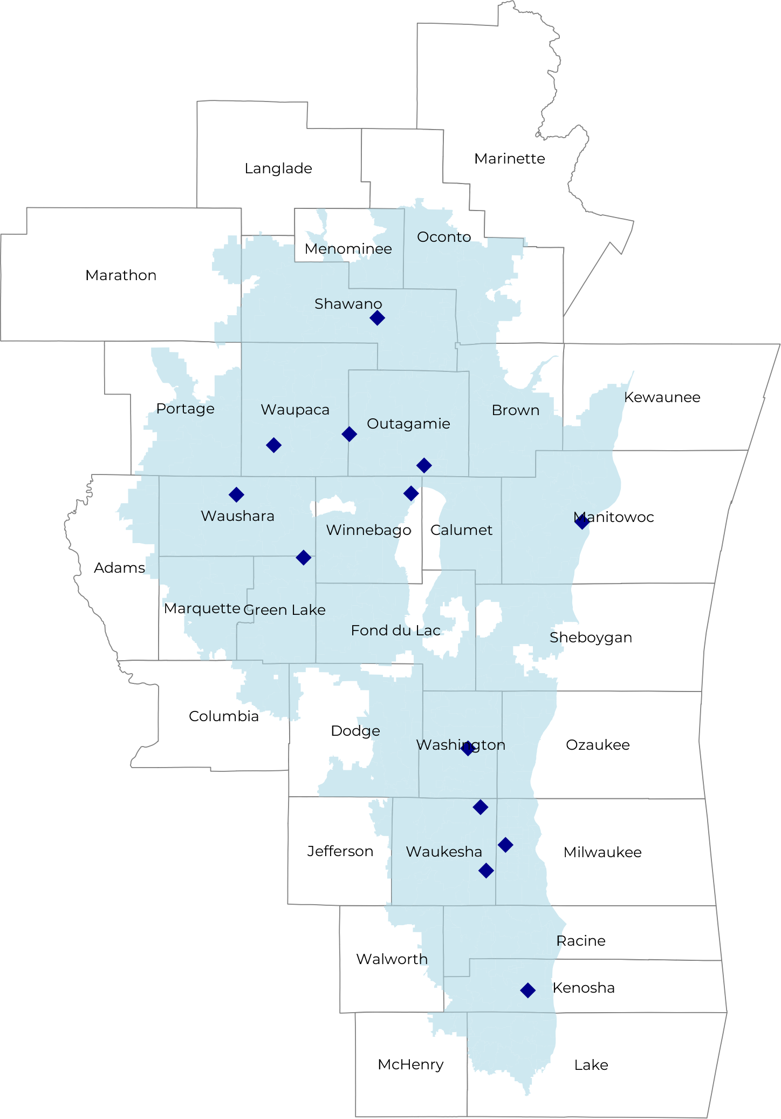
Significant room for plan growth
MARKET OPPORTUNITY
4,400+
900,000+
1,700,000+
Employers
Employees
Members
Commercial employers headquartered in the Froedtert ThedaCare catchment area, by employer size (number of employees)
 | 50-100 | 101-200 | 201-400 | 401-1,000 | 1,001-3,000 | 3,000+
Employers | 2,307 | 1,026 | 619 | 367 | 127 | 78
Employees | 173,000 | 153,900 | 185,700 | 256,900 | 254,000 | 468,000
Members | 311,400 | 277,000 | 334,300 | 462,400 | 457,200 | 842,400

Slide 15
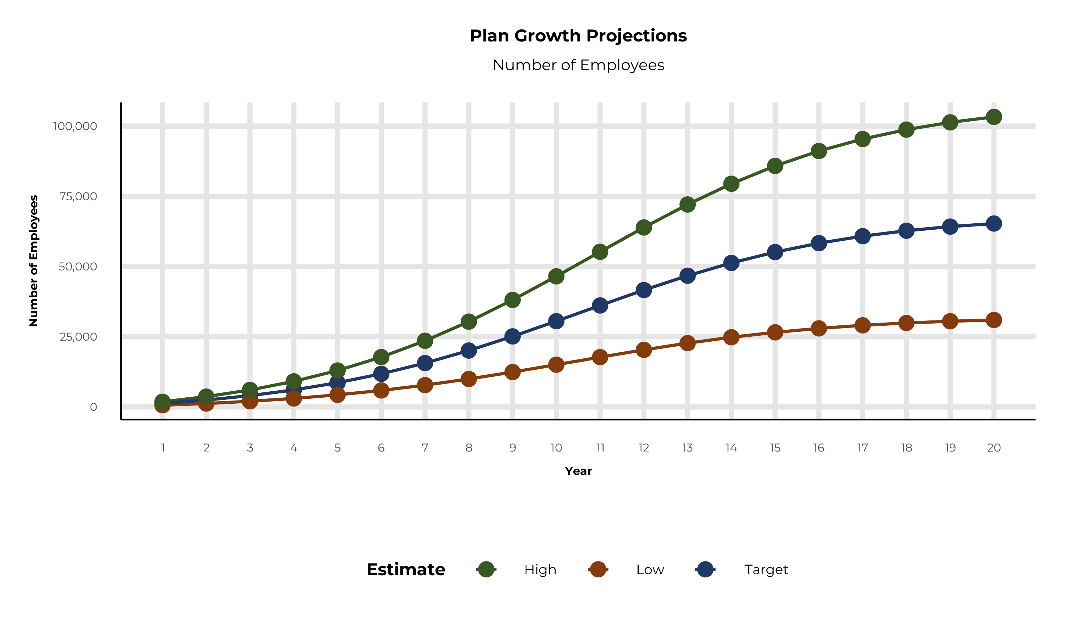
Plan potential growth paths
MARKET OPPORTUNITY
Population
3,500K
Working age
2,056K
Insured
1,546K
Self-funded
895K
Service area includes Lake and McHenry counties in Illinois and Brown, Calumet, Columbia, Dodge, Fond du Lac, Green Lake, Jefferson, Kenosha, Kewaunee, Manitowoc, Marquette, Menominee, Milwaukee, Oconto, Outagamie, Ozaukee, Portage, Racine, Shawano, Sheboygan, Walworth, Washington, Waukesha, Waupaca, Waushara and Winnebago counties in Wisconsin.

Slide 16
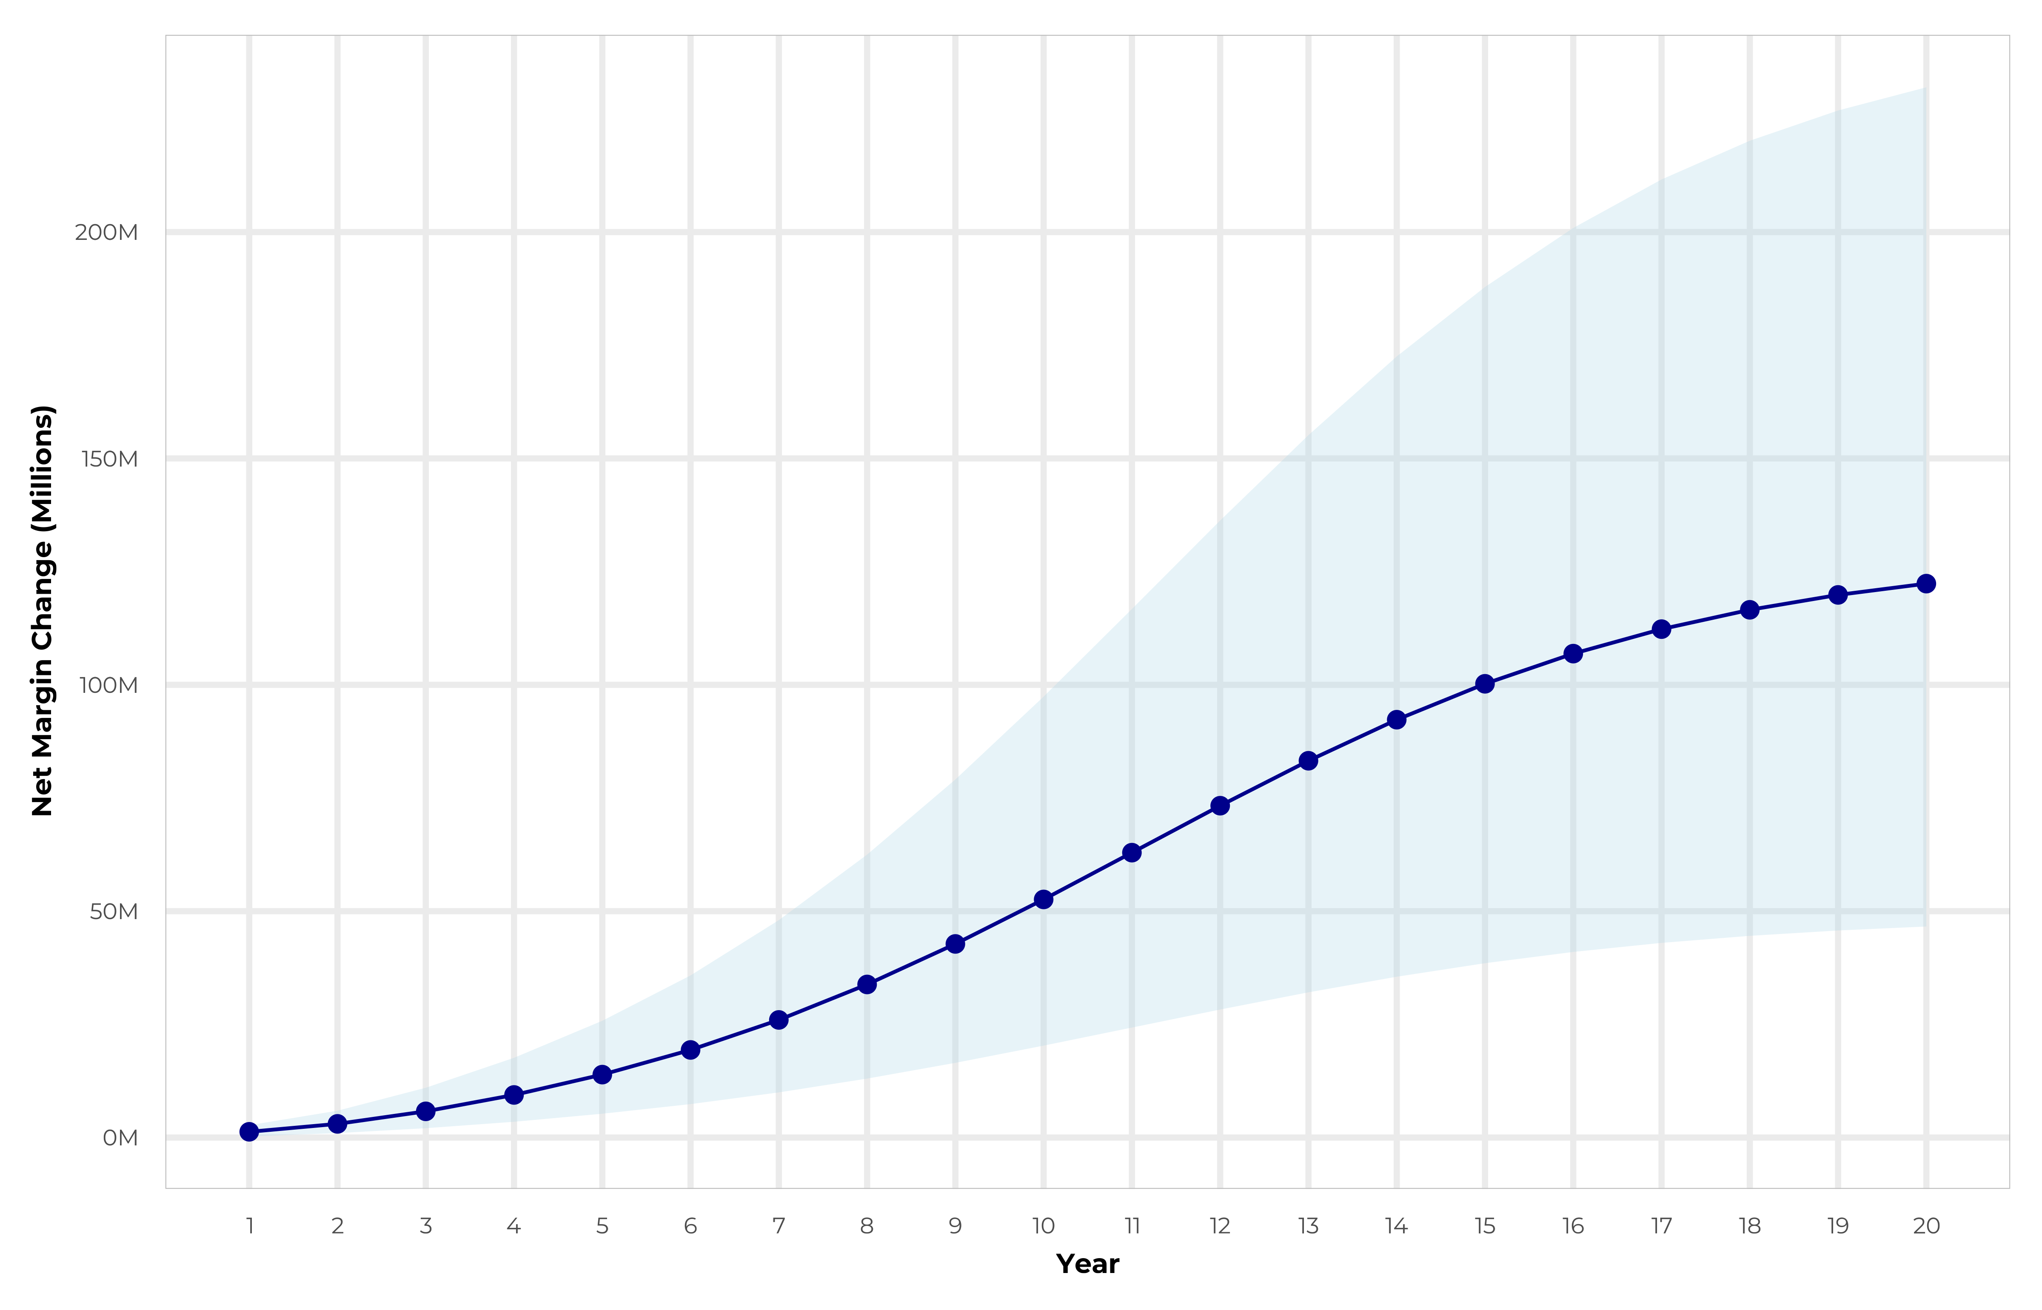
Growing powerful, lasting profitability
LONG-TERM ECONOMICS
Early stage
Net margin change over 20 years: target case, high-to-low range shaded
Gaining name recognition, early growth
New revenue
$29.14M
New profit
$8.79M
Growth stage
Strong reputation, strong growth
New revenue
$174.19M
New profit
$53.51M
Mature stage
High profitability, market saturation
New revenue
$357.94M
New profit
$110.07M

Slide 17
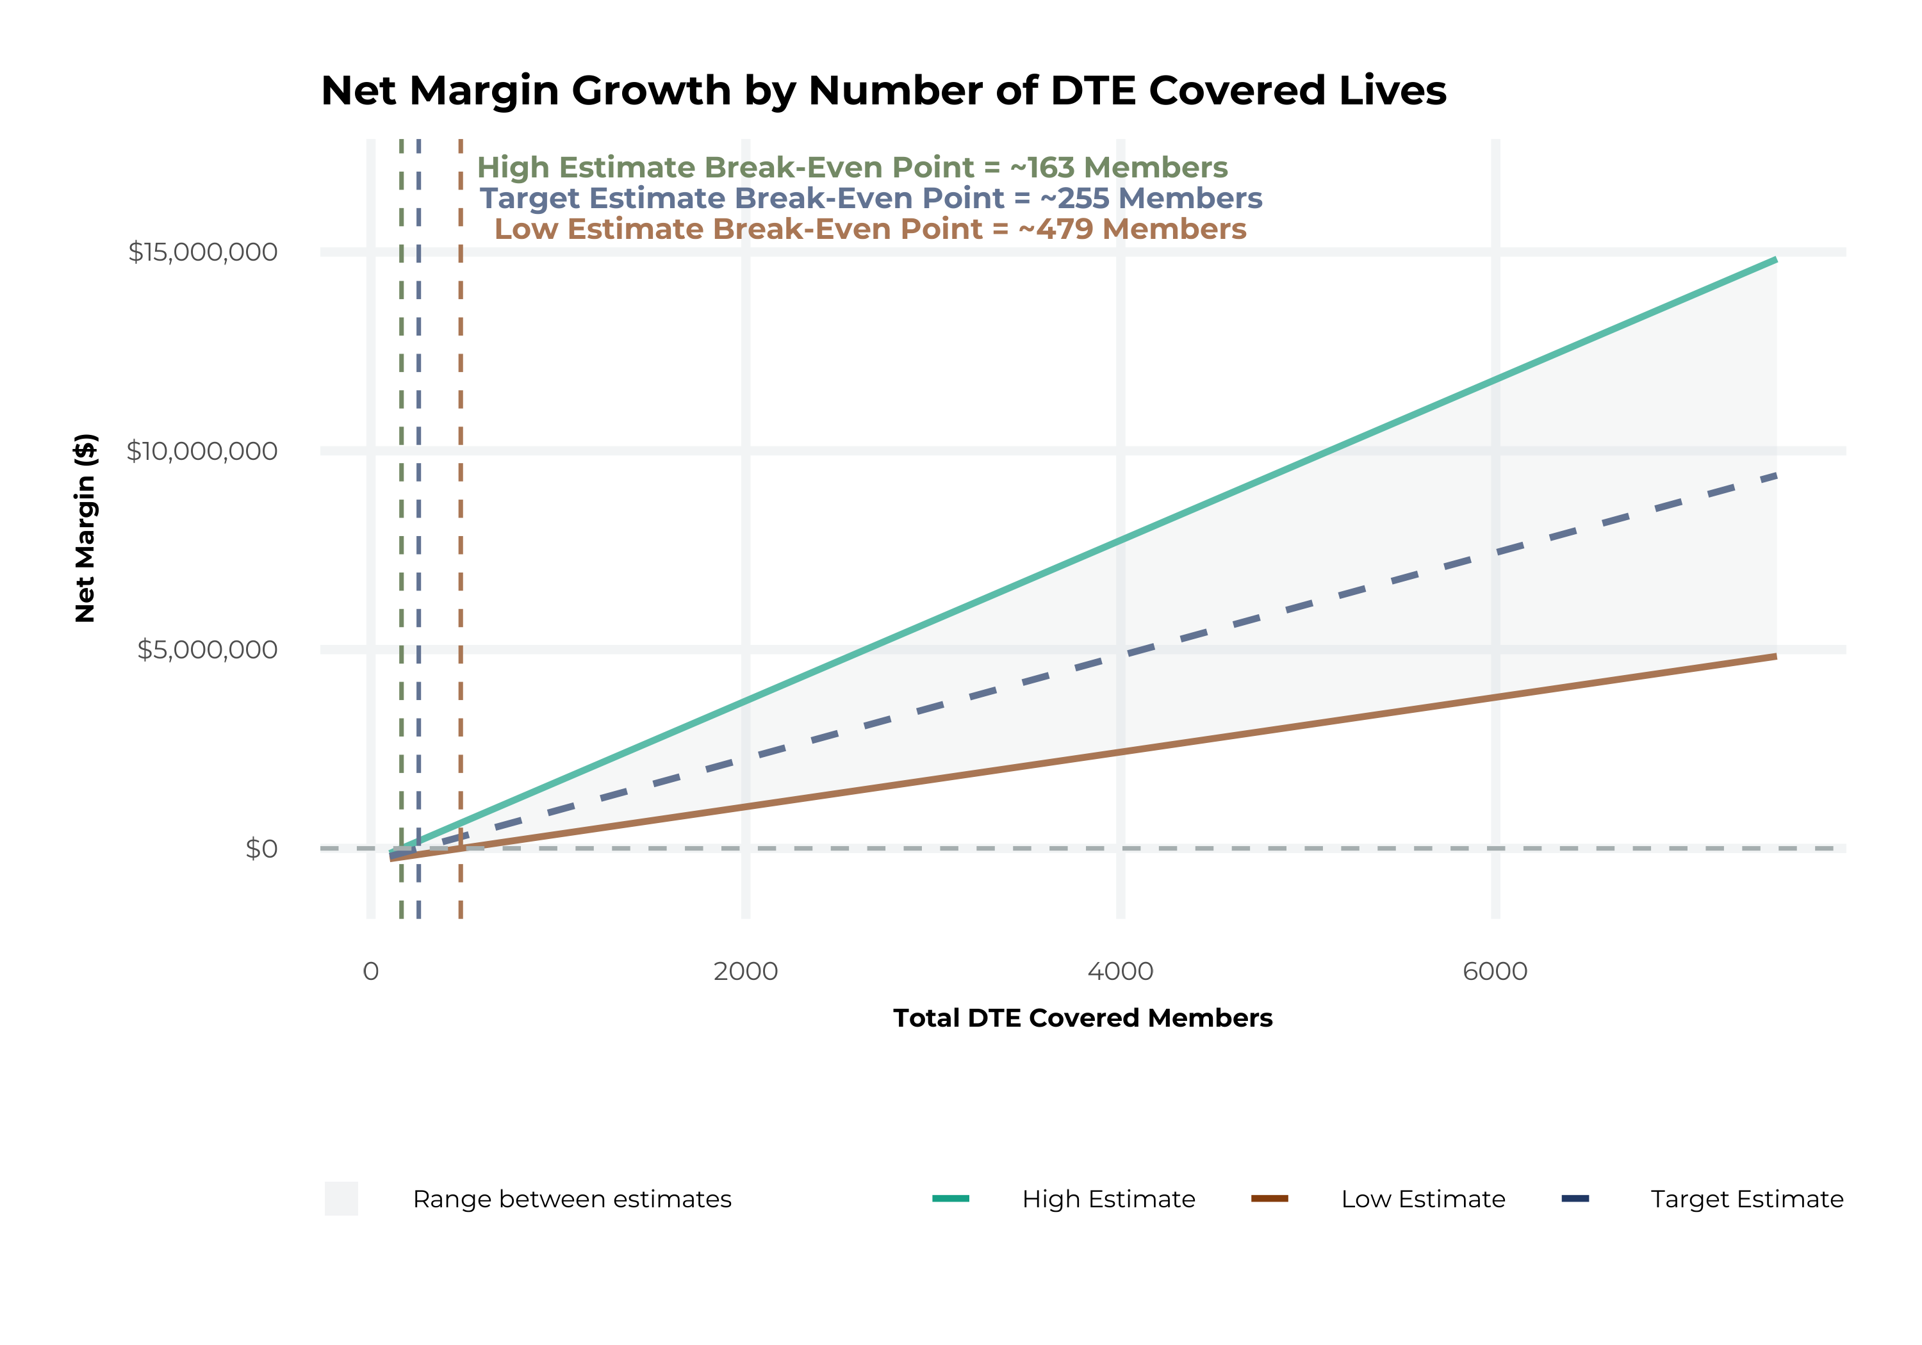
Model assumptions and break-even
MODEL ASSUMPTIONS
Patient steerage
KBA estimates Froedtert ThedaCare has 23% inpatient and 14% outpatient market share in its service area. The tiered DTE design creates immediate steerage, with more over time from member bonus benefits and the Convenience Card.
Low
10% below target
High
10% above target
Commercial margin
KBA observes a 38% Froedtert ThedaCare commercial margin. We conservatively model DTE pricing 10% below market, offset by a 10 point gain from friendlier billing and better patient collections.
Low
25.4%
Target
30.4%
High
35.4%

Slide 18
Net margin change grows to $17.1M by Year 4
FOUR-YEAR PROJECTIONS
Target case ($K) | Year 1 | Year 2 | Year 3 | Year 4
Number of Members | 2,200 | 4,400 | 7,300 | 10,900
Incremental Margin | 2,848.9K | 5,701.2K | 10,729.6K | 17,119.9K
Network Access Fee | 26.4K | 52.8K | 87.6K | 130.8K
Implementation Fee (One-Time) | -150.0K | 0.0K | 0.0K | 0.0K
Sales and Marketing Costs | -180.0K | -180.0K | -180.0K | -180.0K
Net Margin Change | 2,545.3K | 5,574.0K | 10,637.2K | 17,070.7K
HIGH CASE, YEAR 4
$25.8M
16,400 members
LOW CASE, YEAR 4
$8.4M
5,400 members

Slide 19

Margin impact by number of covered members
SINGLE-YEAR SUMMARY
Target estimate: 50%+ within-plan steerage and a 30.4% commercial margin
DTE Members | Pre-DTE Revenue | Pre-DTE Margin | DTE Revenue | DTE Incr. Revenue | DTE Total Margin | DTE Incr. Margin | Net Margin Less DTE Fees
100 | $196K | $59K | $618K | $422K | $188K | $128K | $-201K
500 | $979K | $297K | $3,089K | $2,110K | $939K | $641K | $317K
1,000 | $1,957K | $595K | $6,177K | $4,220K | $1,878K | $1,283K | $965K
2,500 | $4,893K | $1,487K | $15,444K | $10,551K | $4,695K | $3,207K | $2,907K
10,000 | $19,572K | $5,950K | $61,774K | $42,202K | $18,779K | $12,829K | $12,619K
20,000 | $39,144K | $11,900K | $123,548K | $84,405K | $37,559K | $25,659K | $25,569K
Upside not included: 340B. Projections exclude 340B contribution margin, which could reach $136 PMPM by optimizing 340B through Rx plan design, Froedtert ThedaCare's approved sites with network integration, and a Froedtert ThedaCare proprietary PBM program. Detailed analysis is in the appendix.

Slide 20
Steering members to Froedtert ThedaCare
03
The Key Incentive Plan turns preferred-provider choice into real dollars for members

Slide 21




Affordability without compromise
THE KEY INCENTIVE PLAN
Employers take back control of their healthcare programs while members keep freedom of choice and are rewarded for choosing high-quality, cost-effective care.
Basic medical benefit
Preferred Plus Benefits*
Health Guardian Account
Customized major medical plan with access to a broad network of providers.
Benefits paid at preferred providers: real dollars to members who get the care they need, when they need it.
KBA tracks and administers Preferred Plus Benefits, out-of-pocket expenses and the Convenience Card.
Healthcare Convenience Card
Chronic disease and acute illness management
PBM, specialty Rx and GLP-1 program
0% interest, no-fee card for out-of-pocket expenses at preferred providers.
Patented program covering 28 chronic illnesses with 11% to 17% savings and a $14 to $1 ROI.
Transparent Rx programs with 1-on-1 coaching: about 20%+ savings on Rx and 10% on overall claims.
*Daily inpatient hospital benefit, OP surgery/anesthesia, OP radiology/X-ray, OP diagnostic labs, health screening benefit, wellness benefit, critical illness

Slide 22
Base medical + Preferred Plus: the deductible can vanish
THE KEY INCENTIVE PLAN
Example: a member with a $2,500 deductible and $4,500 out-of-pocket maximum has a heart attack and cardiac surgery with a 5-day inpatient stay. At a preferred provider, $4,925 in Preferred Plus Benefits cover the full $4,500 out-of-pocket, so the member owes $0. At a non-preferred provider, the member owes $4,500.
Base medical benefits*
Deductible (single / family) | $2,500 / $4,500
Coinsurance | 80% / 20%
Max out-of-pocket (single / family) | $4,500 / $9,000
Chronic disease regimens of care | Covered at 100%
Healthcare Convenience Card | 0% interest
Health Guardian Account | Included
Preferred Plus Benefits | Preferred | Non-preferred
OP radiology / X-ray | $200 | $0
OP diagnostic labs | $100 | $0
Preferred hospital stay ($500/day, 5 days) | $2,500 | $0
Critical illness benefit | $2,000 | $0
Health screening benefit | $125 | $0
Total employee out-of-pocket | $4,500 | $4,500
Preferred Plus Benefits | $4,925 | $0
Employee amount due to provider | $0 | $4,500
Added to Health Guardian Account | $425 | $0
*Base medical benefits are for illustration only and can be customized to client needs.

Slide 23

The benefit steers the patient to Froedtert ThedaCare
WHAT WILL THIS CLAIM COST ME?
Explanation of benefits: heart attack, cardiac surgery
THE CHARGES
Medical bills | $25,000
Out-of-pocket due to provider | $4,500
THE CREDITS
OP radiology / X-ray | $200
OP diagnostic labs | $100
Preferred hospital stay ($500/day, 5 days) | $2,500
Critical illness benefit | $2,000
Health screening benefit | $125
Benefit total | $4,925
Out-of-pocket paid to hospital | ($4,500)
Balance paid to Health Guardian Account | $425
Froedtert ThedaCare patients can have all out-of-pocket liability reduced to $0

Slide 24

Creating EPO steerage in a PPO network
THE KBA HEALTHCARE CONVENIENCE CARD
The card works only for specific merchant codes, so it rewards care at preferred providers.
1
Use at specific healthcare providers
Designated hospitals, urgent care facilities, physicians and eligible ancillary providers
2
Out-of-pocket expenses qualify
3
0% interest rate
4
Employee sets the repayment schedule
5
Simple to qualify
Answer one simple question

Slide 25
GLP-1s that don't break the bank
WEIGHT MANAGEMENT
Prime Therapeutics reports GLP-1 spend per member per month tripled by March 2025, now about 15% of total pharmacy spend, with more than 1 in 50 members filing a GLP-1 claim in Q1 2025.
THE CHALLENGE
OUR SOLUTION
THE IMPACT
$1,089-$1,349
$249
$7M
per month for traditional GLP-1s, an unsustainable cost that limits employee access
per month for generic GLP-1 medications secured by Key Benefits, with strict budget control
saved by one major city that was spending $11M a year on GLP-1s
Beyond medication: comprehensive care
Members get specialized coaching twice a month on keeping muscle strength, moderate exercise and lasting lifestyle changes that sustain weight loss after GLP-1 treatment ends.
270
conditions linked to obesity (Cleveland Clinic)
$8.5K
added annual cost per obese individual (KFF)

Slide 26
Platform and go-to-market
04
Clinical integration, pharmacy, stop-loss, sales and implementation

Slide 27


Integration with the Epic EHR
CLINICAL INTEGRATION
KBA shares evidence-based standards of care for 27 chronic conditions directly into Epic, so Froedtert ThedaCare clinicians see gaps in care at the point of care.
Example standard: Hyperthyroidism: yearly clinical evaluation, TSH and T4

Slide 28




The missing piece to value-based care
VALUE-BASED CARE
Patient engagement is the weak link in value-based care. Froedtert ThedaCare's clinical leadership and employer participation can drive better outcomes.
KBA's proactive care management team supplements Froedtert ThedaCare's own outreach to patients.
Froedtert ThedaCare excels in standards-of-care completion for the chronically ill, improving care and cost.
Integrating Froedtert ThedaCare's managed care with KBA's programs positions Froedtert ThedaCare as the value leader.

Slide 29

Transparent PBM integration
PHARMACY
Froedtert ThedaCare-centered pharmacy
Clinical flexibility
Custom client support
Support Froedtert ThedaCare's retail pharmacies
Optimize Froedtert ThedaCare's 340B drug pricing program
Option for Froedtert ThedaCare to create its own PBM program
Custom phone number with personalized scripting and call tracking
Customizable member welcome booklet and materials
White-labeled formulary and marketing materials
Full portfolio of custom formularies with an optimized formulary shield
Clinical programs that advance the overall DTE strategy
More drug savings by moving members to lower-cost alternatives
Customize or layer on utilization management programs
Specialized call center capabilities
Fully customizable plan designs
Operational access to the platform
Processes customized to promote the DTE strategy

Slide 30

The KBA stop-loss experience
STOP-LOSS INSURANCE
20+
$150M+
CARRIER RELATIONSHIPS INCLUDE
stop-loss underwriters and carriers
annual stop-loss premium placed
Tokio Marine
Nationwide
Comprehensive pricing and medical service analysis for every DTE plan ensures proper pricing. KBA provides the administration the stop-loss markets require:
Berkshire Hathaway
Sun Life
Liberty Mutual
Granular (Google)
Bordereau reporting
Claim reporting and reconciliation
Evaluation of networks
Care management
Companion Life
Crum & Forster
Initial underwriting
Negotiation of rates and terms
American Fidelity
RGA
Plan design actuarial

Slide 31





KBA works with you to manage and sell
DTE PROGRAM MARKETING AND SALES
Branding and messaging
Direct and brokerage sales distribution with a focused sales representative
Brochures, website and media
Stop-loss and level-funded options down to 20 employee lives
Sell through established brokers in your service area

Slide 32

A community-based sales strategy
SALES STRATEGY
1
A locally based sales rep with strong community ties
2
Work with DTE provider partners to identify strategic employers for early adoption
3
Partner with select brokers whose incentives and goals are aligned
4
Shared pipeline reporting and collaboration with DTE provider partners
5
Marketing and promotion of the new option in the community

Slide 33





A complete marketing system
MARKETING
Customized branding and messaging
Customized brochures
Customized website
Targeted employer outreach
Sales system: social media, email, text and more
Sample private-label plan website

Slide 34
Everyone at the table wins
COLLABORATION OF STAKEHOLDERS
Key Benefit Administrators
Froedtert ThedaCare's DTE
Employer
Employee
Full TPA administration
Stop-loss administration
True transparency and analytics
Population health management
Utilization and case management
Sales and marketing
Transparent PBM
Website and mobile app
Customizable options and plans
Incremental revenue and margin
Branding and messaging
Benefit plan integration
Network steerage
Direct relationship with self-funded employers
Referral authorization
Plan transparency
Direct access to members
Reduced spend
"At the table" with Froedtert ThedaCare
Improved analytics
Complete transparency
Lower stop-loss
Benefit plan stabilization
Healthier population
Reduced out-of-pocket
Improved health
Better coordination and navigation of care
Direct access to the best medical providers

Slide 35
Who does what
ROLES AND RESPONSIBILITIES
Froedtert ThedaCare
KBA Operations
Tier 1 provider network
Provider recruitment, if necessary
Network pricing and contract terms
Referral management protocols and approvals
Medical director oversight
Practice improvement program using KBA/AHDI data, with KBA assistance
Network evaluation: actuarial pricing
PPO wrap and tertiary transplant network, if needed
Claims administration
Plan design development, testing and administration
Employer, member and provider customer service
Customized member, provider, agent and HR portal
Billing, enrollment and premium management
Fulfillment: SPD and customized ID cards
COBRA/HIPAA administration
Out-of-network negotiations
Wrap PPO repricing
Nurse coaching for the chronically ill
Nurse triage to physicians and facilities
Stop-loss underwriting, pricing and placement
Stop-loss claims administration
Complex case management
PBM administration interface
Reporting: utilization, gaps in care, physician profiling, referrals, chronic disease, employer risk
Ancillary administration: dental, vision, life, 5500 and more
HSA, FSA and HRA administration
Sales and marketing plan: branding, distribution, sales management
KBA Consulting
Program oversight and integration across the enterprise
Goal development, agreement and tracking
Start-up assessments: market, network, operations and readiness
Draft business plan with financial projections
Engagement with Froedtert ThedaCare's C-suite, operations, HR, managed care, marketing, strategy and business development

Slide 36



Get the network and the pricing right first
PRE-IMPLEMENTATION
STEP 1
STEP 2
Provider file
Pricing
Determine gaps in medical service delivery
Identify other key providers to potentially contract with on behalf of Froedtert ThedaCare
Wrap the network to cover all other provider types
Dial in competitive stop-loss rates and Froedtert ThedaCare's net revenue and margins
Actuarial evaluation compared to the market

Slide 37

From decision to go-live in 6 to 8 months
IMPLEMENTATION
MONTH 0
MONTH 1
MONTHS 1-6
MONTHS 3-6
MONTHS 6-8
Pre-implementation
Agreement and project scope
Implementation
Sales and marketing
Go live
Network gap and pricing analysis
Market outreach begins in month 3
Hire the sales executive
First employer groups enroll
Recommended next step: a working session with Froedtert ThedaCare leadership to confirm the service area and plan goals, and start the pre-implementation network and pricing analysis.

Slide 38
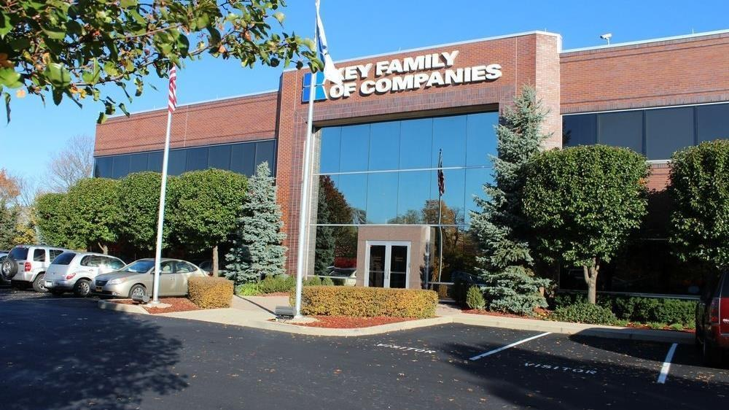

A partner you can trust
Our objectives are aligned
We know the market
Completely transparent
The sophistication and infrastructure to compete
Derek Moore
Senior Vice President, Key Benefit Administrators
845-283-9973 | derek.moore@keybenefit.com

Slide 39
Appendix: financial projections and assumptions
A
Payer mix, margin, market share, steerage and scenario detail for a Froedtert ThedaCare-branded plan

Slide 40
Estimated Froedtert ThedaCare 2023 payer mix
APPENDIX
Payer Group | Total Inpatient Days | Revenue | Payer Mix
All Froedtert ThedaCare Health | 386,125 | $4,603,991K | 100%
Medicare | 91,422 | $566,838K | 23%
Medicaid | 27,943 | $289,613K | 7%
Other Government Pay | 0 | - | -
No-Pay, Charity Care | 20,279 | -$251,776K | 5%
Commercial/Self Pay | 246,481 | $3,745,592K | 64%
Estimating payer mix
Medicare, Medicaid and other government mixes are each group's inpatient days divided by total inpatient days.
No-pay and charity care is no-pay/charity revenue as a share of total revenue.
Commercial/self-pay is the remainder.
Estimating inpatient days
No-pay and commercial days are their payer mix shares multiplied by total inpatient days.
Outpatient payer mix is assumed to mirror inpatient. Total Medicare revenue is from MedPAR.
Values from the CMS Medicare Provider Cost Report, Definitive Healthcare and MedPAR.

Slide 41
Estimated margin: commercial vs. government pay
APPENDIX
RAND data estimates Froedtert ThedaCare commercial reimbursement at 432% of Medicare rates.
Commercial margin
Government-pay margin
Counterfactual: all government-pay patients paid at commercial rates
Counterfactual: all commercial patients paid at Medicare rates
Commercial Revenue | $3,745,592K
Gov-pay revenue at 432% current rate | $3,703,772K
Total Revenue | $7,449,364K
Total Costs | $4,652,634K
Net Income | $2,796,730K
Commercial Revenue Divided by 432% | $866,122K
Gov-pay revenue | $856,452K
Total Revenue | $1,722,574K
Total Costs | $4,652,634K
Net Income | $-2,930,061K
38%
-170%

Slide 42
Inpatient market share by health system
APPENDIX
23%
Froedtert ThedaCare inpatient share today
14%
Outpatient share*
67%
Modeled inpatient steerage for plan members by Year 4
Share of inpatient charges at hospitals in the Froedtert ThedaCare service area, grouped by system. *Outpatient share assumes 66% of local physicians are employed by area hospitals (Physician Advocacy Institute).

Slide 43
Estimating market share (1 of 3)
APPENDIX
Hospital | Beds | Inpatient charges | Outpatient charges | IP share | OP share*
Froedtert Pleasant Prairie Hospital | 151 | $448,974.7K | $1,086,216.6K | 2% | 2%
ThedaCare Regional Medical Center - Neenah | 166 | $379,557.2K | $501,903.8K | 1% | 1%
Froedtert West Bend Hospital | 70 | $185,847.0K | $407,098.3K | 1% | 1%
Froedtert Menomonee Falls Hospital | 130 | $450,588.5K | $682,876.0K | 2% | 1%
Holy Family Memorial Medical Center | 45 | $67,843.0K | $266,445.2K | <1% | <1%
ThedaCare Regional Medical Center - Appleton | 146 | $401,249.4K | $991,381.8K | 2% | 1%
Froedtert Hospital | 731 | $4,015,623.7K | $4,949,722.6K | 15% | 7%
Froedtert Community Hospital - New Berlin | 16 | $6,982.3K | $158,651.7K | <1% | <1%
ThedaCare Medical Center - Wild Rose | 10 | $5,211.2K | $29,304.4K | <1% | <1%
ThedaCare Medical Center - New London | 17 | $10,450.6K | $86,431.1K | <1% | <1%
ThedaCare Medical Center - Waupaca | 25 | $21,117.5K | $145,003.7K | <1% | <1%
ThedaCare Medical Center - Shawano | 25 | $38,383.1K | $262,196.2K | <1% | <1%
ThedaCare Medical Center - Berlin | 23 | $29,956.1K | $149,536.2K | <1% | <1%
Vista Medical Center East | 166 | $329,202.1K | $368,518.8K | 1% | 1%
City of Hope Chicago | 73 | $95,221.4K | $858,592.9K | <1% | 1%
Northwestern Medicine McHenry Hospital | 460 | $1,493,402.5K | $2,477,148.2K | 6% | 4%
Northwestern Medicine Lake Forest Hospital | 140 | $967,267.1K | $2,896,624.4K | 4% | 4%
Advocate Condell Medical Center | 275 | $1,329,374.7K | $1,143,250.9K | 5% | 2%
Captain James A Lovell Federal Health Care Center | 199 | n/a | n/a | n/a | n/a
Encompass Heath Rehabilitation Hospital of Libertyville | 60 | $42,182.7K | $0.3K | <1% | <1%
Lake Behavioral Hospital | 161 | $121,384.3K | $4,748.7K | <1% | <1%
Aspirus Stevens Point Hospital | 82 | $111,427.6K | $443,992.4K | <1% | 1%
ProHealth Waukesha Memorial Hospital | 272 | $926,784.3K | $1,602,719.0K | 4% | 2%
Ascension NE Wisconsin - St Elizabeth Campus | 244 | $391,725.0K | $839,104.8K | 2% | 1%
Aurora Medical Center - Manitowoc County | 57 | $83,700.0K | $312,876.2K | <1% | <1%
Aurora Medical Center - Sheboygan County | 118 | $270,769.7K | $812,722.8K | 1% | 1%
Froedtert ThedaCare facilities in green. *Outpatient share assumes 66% of local physicians are employed by area hospitals (Physician Advocacy Institute, Avalere Physician Employment Trends Study 2019-2023).

Slide 44
Estimating market share (2 of 3)
APPENDIX
Hospital | Beds | Inpatient charges | Outpatient charges | IP share | OP share*
Aurora Medical Center - Washington County | 35 | $62,228.4K | $285,053.6K | <1% | <1%
Clement J Zablocki VA Medical Center | 196 | n/a | n/a | n/a | n/a
HSHS St Nicholas Hospital | 47 | $52,929.2K | $314,550.2K | <1% | <1%
Ascension NE Wisconsin - Mercy Campus | 104 | $81,028.9K | $150,633.6K | <1% | <1%
Bellin Hospital Green Bay | 259 | $388,201.1K | $1,924,088.6K | 1% | 3%
Ascension Columbia St Marys Hospital Milwaukee | 672 | $973,041.1K | $1,432,694.8K | 4% | 2%
Aurora Medical Center - Burlington | 43 | $127,546.0K | $415,917.2K | <1% | 1%
ProHealth Oconomowoc Memorial Hospital | 63 | $139,973.8K | $366,800.4K | 1% | 1%
HSHS St Vincent Hospital | 210 | $661,404.3K | $1,605,282.3K | 3% | 2%
Ascension St Francis Hospital | 73 | $55,388.4K | $362,458.7K | <1% | 1%
SSM Health St Agnes Hospital - Fond du Lac | 105 | $345,010.4K | $946,329.7K | 1% | 1%
Ascension All Saints Hospital - Spring Street Campus | 263 | $319,632.8K | $681,600.9K | 1% | 1%
HSHS St Marys Hospital Medical Center | 72 | $161,278.5K | $384,894.1K | 1% | 1%
Watertown Regional Medical Center | 76 | $124,250.1K | $247,613.6K | <1% | <1%
Ascension SE Wisconsin Hospital - St Joseph Campus | 344 | $415,981.8K | $948,121.0K | 2% | 1%
Aurora St Lukes Medical Center | 1,290 | $4,531,393.5K | $5,345,191.4K | 17% | 8%
Aurora West Allis Medical Center | 202 | $589,047.6K | $879,294.0K | 2% | 1%
Aurora Medical Center - Kenosha | 74 | $509,168.1K | $1,129,537.7K | 2% | 2%
Aurora BayCare Medical Center | 167 | $662,207.8K | $1,710,735.6K | 3% | 3%
Orthopaedic Hospital of Wisconsin | 30 | $31,697.1K | $243,500.8K | <1% | <1%
Aurora Medical Center - Oshkosh | 84 | $201,732.5K | $781,075.6K | 1% | 1%
Midwest Orthopedic Specialty Hospital | 16 | $40,849.3K | $239,399.6K | <1% | <1%
Aurora Medical Center - Summit | 109 | $264,401.9K | $533,054.2K | 1% | 1%
Aurora Medical Center - Grafton | 132 | $590,809.2K | $934,913.7K | 2% | 1%
Ascension Wisconsin Hospital - Menomonee Falls | 16 | $3,200.2K | $88,041.6K | <1% | <1%
Marshfield Medical Center - River Region at Stevens Point | 5 | $2,182.8K | $115,311.8K | <1% | <1%
Froedtert ThedaCare facilities in green. *Outpatient share assumes 66% of local physicians are employed by area hospitals (Physician Advocacy Institute, Avalere Physician Employment Trends Study 2019-2023).

Slide 45
Estimating market share (3 of 3)
APPENDIX
Hospital | Beds | Inpatient charges | Outpatient charges | IP share | OP share*
HSHS St Clare Memorial Hospital | 23 | $9,476.2K | $72,981.8K | <1% | <1%
Ascension Calumet Hospital | 25 | $3,137.5K | $65,875.0K | <1% | <1%
SSM Health Ripon Community Hospital | 15 | $16,323.0K | $71,431.1K | <1% | <1%
SSM Health Waupun Memorial Hospital | 25 | $27,847.4K | $169,186.4K | <1% | <1%
Lakeview Specialty Hospital & Rehab | 35 | $66,663.8K | $958.7K | <1% | <1%
Select Specialty Hospital - Milwaukee West Allis | 63 | $389,658.8K | $142.1K | 1% | <1%
Ascension Sacred Heart Rehabilitation Hospital | 15 | $22,302.8K | $3,748.5K | <1% | <1%
ProHealth Rehabilitation Hospital of Wisconsin | 40 | $35,032.1K | $3,608.6K | <1% | <1%
Milwaukee Rehabilitation Hospital at Greenfield | 40 | $36,463.7K | n/a | <1% | n/a
Green Bay Rehabilitation Hospital | 40 | $32,679.7K | n/a | <1% | n/a
ClearSky Rehabilitation Hospital of Kenosha | 39 | $19,806.4K | n/a | <1% | n/a
ClearSky Rehabilitation Hospital Lakeshore | 36 | n/a | n/a | n/a | n/a
Childrens Wisconsin - Milwaukee Campus | 309 | $1,032,396.7K | $828,251.8K | 4% | 1%
Fox Valley Hospital-Childrens Wisconsin | 42 | $34,186.9K | $12,447.5K | <1% | <1%
Aurora Psychiatric Hospital | 72 | $103,103.5K | $63,406.4K | <1% | <1%
Winnebago Mental Health Institute | 335 | $65,740.8K | n/a | <1% | n/a
Brown County Community Treatment Center | 16 | $14,431.9K | $380.1K | <1% | <1%
Rogers Behavioral Health in Oconomowoc | 90 | $306,305.4K | $190,986.8K | 1% | <1%
Fond Du Lac County Acute Psychiatric Unit | 16 | $4,915.6K | $6,434.6K | <1% | <1%
Waukesha County Mental Health Center | 16 | $6,383.1K | n/a | <1% | n/a
Willow Creek Behavioral Health | 72 | $55,552.6K | $7,833.4K | <1% | <1%
Granite Hills Hospital | 60 | $39,205.3K | $672.3K | <1% | <1%
Mental Health Emergency Center Inc | 6 | $169.6K | $27,085.0K | <1% | <1%
Rogers Behavioral Health in Brown Deer | 56 | $66,557.3K | $14,422.0K | <1% | <1%
Rogers Behavioral Health in West Allis | 81 | $96,020.1K | n/a | <1% | n/a
Froedtert ThedaCare facilities in green. *Outpatient share assumes 66% of local physicians are employed by area hospitals (Physician Advocacy Institute, Avalere Physician Employment Trends Study 2019-2023).

Slide 46
Froedtert ThedaCare hospital metrics
APPENDIX
Hospital | Inpatient revenue | Outpatient revenue | Commercial revenue | Operating expenses | Net income | Commercial mix | Commercial margin
Froedtert Pleasant Prairie Hospital | $131,999K | $319,348K | $375,659K | $446,758K | $4,695K | 56.7% | 36.5%
ThedaCare Regional Medical Center - Neenah | $138,918K | $183,697K | $278,148K | $278,781K | $44,164K | 73.8% | 40.9%
Froedtert West Bend Hospital | $46,833K | $102,589K | $127,986K | $164,575K | $-14,857K | 57.9% | 25.9%
Froedtert Menomonee Falls Hospital | $118,505K | $179,596K | $247,889K | $298,888K | $-1,059K | 58.2% | 35.6%
Holy Family Memorial Medical Center | $16,418K | $64,480K | $67,162K | $114,362K | $-33,448K | 52.7% | 9.7%
ThedaCare Regional Medical Center - Appleton | $140,839K | $347,975K | $418,112K | $427,464K | $61,872K | 72.5% | 41.1%
Froedtert Hospital | $1,108,312K | $1,366,123K | $1,944,768K | $2,632,676K | $-160,959K | 63.4% | 37.7%
Froedtert Community Hospital - New Berlin | $1,857K | $42,201K | $39,418K | $29,622K | $14,367K | 77.5% | 50.0%
ThedaCare Medical Center - Wild Rose | $2,131K | $11,985K | $11,133K | $13,970K | $161K | 66.9% | 42.0%
ThedaCare Medical Center - New London | $4,086K | $33,795K | $32,263K | $34,122K | $3,728K | 65.5% | 39.5%
ThedaCare Medical Center - Waupaca | $7,771K | $53,361K | $52,002K | $55,837K | $5,358K | 67.2% | 39.1%
ThedaCare Medical Center - Shawano | $14,586K | $99,635K | $93,968K | $96,701K | $17,371K | 67.1% | 46.5%
ThedaCare Medical Center - Berlin | $11,174K | $55,777K | $57,083K | $58,878K | $8,017K | 66.1% | 40.8%
Source: CMS provider cost reports; Medicare costs from MedPAR. Metrics labeled "estimated" are derived from other data points. Full metric set available on request.

Slide 47
Steerage rates for current DTE networks
APPENDIX
83%
average Tier 1 steerage across KBA DTE networks
Data collected from KBA DTE networks in Q1 2024.

Slide 48
Projected plan growth over 20 years
APPENDIX
Year | Employees | Members | Froedtert ThedaCare share of inpatient care | Froedtert ThedaCare share of outpatient care
1 | 1,200 | 2,200 | 60% | 50%
2 | 2,400 | 4,300 | 60% | 50%
3 | 4,000 | 7,200 | 65% | 55%
4 | 6,100 | 11,000 | 67% | 58%
5 | 8,600 | 15,500 | 68% | 60%
6 | 11,800 | 21,200 | 68% | 60%
7 | 15,600 | 28,100 | 69% | 61%
8 | 20,100 | 36,200 | 69% | 62%
9 | 25,100 | 45,200 | 69% | 62%
10 | 30,500 | 54,900 | 70% | 63%
11 | 36,100 | 65,000 | 70% | 63%
12 | 41,600 | 74,900 | 70% | 64%
13 | 46,700 | 84,100 | 71% | 64%
14 | 51,300 | 92,300 | 71% | 65%
15 | 55,100 | 99,200 | 71% | 66%
16 | 58,300 | 104,900 | 72% | 66%
17 | 60,800 | 109,400 | 72% | 66%
18 | 62,700 | 112,900 | 72% | 67%
19 | 64,200 | 115,600 | 72% | 67%
20 | 65,300 | 117,500 | 72% | 67%
KBA estimates Froedtert ThedaCare holds 23% inpatient and 14% outpatient market share in its service area today.
Based on prior DTE experience, KBA expects a significant jump in steerage to Froedtert ThedaCare.
More steerage comes from member bonus benefits and the Convenience Card.
High estimates start about 10% above target and low estimates about 10% below.
Year 4 (highlighted) is the basis for the Year 4 projections.

Slide 49
Year 4 projected revenue and profit
APPENDIX
Pre-DTE cohort of 10,900 members | Inpatient | Outpatient | Professional | Total
Revenue† | $8,111,684 | $9,012,728 | $4,208,867 | $21,333,280
Net Income‡ | $2,465,952 | $2,739,869 | $1,279,496 | $6,485,317
Year 4 profit bridge
Total Increase in Net Income | $16,989,139
Network Access Fee (Revenue) of $1 PMPM | $130,800
Total Profit Growth | $17,119,939
Minus Implementation Fee (One-Time) | -$0
Minus Sales and Marketing (Annual – Ongoing) | -$180,000
Total | $16,939,939
† Proportional revenue from 23% inpatient and 14% outpatient market share. ‡ Commercial margin of 30.4% (80% of the estimated commercial margin).
With DTE | Inpatient | Outpatient | Professional | Total
Revenue⁰ | $23,396,414 | $36,688,823 | $17,133,369 | $77,218,606
Net Income* | $7,112,510 | $11,153,402 | $5,208,544 | $23,474,456
⁰ 67% inpatient and 58% outpatient steerage based on KBA DTE experience. * 30.4% commercial margin, less 10 points for competitive rates, plus 10 points for lower billing costs and better patient collections via the Convenience Card.

Slide 50
Target scenario detail by service line ($K)
APPENDIX
Target estimate: 50%+ within-plan steerage, 30.4% commercial margin, modeled with Year 1 fees and steerage
Metric | 500 lives | 1000 lives | 5000 lives | 25000 lives
Pre-DTE Group Inpatient Revenue | $372.1 | $744.2 | $3,721.0 | $18,604.8
Pre-DTE Group Inpatient Margin | $113.1 | $226.2 | $1,131.2 | $5,655.9
DTE Group Inpatient Revenue | $958.7 | $1,917.3 | $9,586.6 | $47,932.8
DTE Group Inpatient Margin | $291.4 | $582.9 | $2,914.3 | $14,571.6
DTE Group Incremental Inpatient Revenue | $586.6 | $1,173.1 | $5,865.6 | $29,328.0
DTE Group Incremental Inpatient Margin | $178.3 | $356.6 | $1,783.1 | $8,915.7
Pre-DTE Group Outpatient Revenue | $413.4 | $826.9 | $4,134.3 | $20,671.4
Pre-DTE Group Outpatient Margin | $125.7 | $251.4 | $1,256.8 | $6,284.1
DTE Group Outpatient Revenue | $1,452.0 | $2,904.0 | $14,519.8 | $72,599.2
DTE Group Outpatient Margin | $441.4 | $882.8 | $4,414.0 | $22,070.2
DTE Group Incremental Outpatient Revenue | $1,038.6 | $2,077.1 | $10,385.6 | $51,927.8
DTE Group Incremental Outpatient Margin | $315.7 | $631.4 | $3,157.2 | $15,786.1
Pre-DTE Group Professional Revenue | $193.1 | $386.1 | $1,930.7 | $9,653.4
Pre-DTE Group Professional Margin | $58.7 | $117.4 | $586.9 | $2,934.6
DTE Group Professional Revenue | $678.1 | $1,356.1 | $6,780.6 | $33,903.2
DTE Group Professional Margin | $206.1 | $412.3 | $2,061.3 | $10,306.6
DTE Group Incremental Professional Revenue | $485.0 | $970.0 | $4,850.0 | $24,249.9
DTE Group Incremental Professional Margin | $147.4 | $294.9 | $1,474.4 | $7,372.0
Net Margin Less DTE Fees | $317.5 | $964.9 | $6,144.7 | $32,043.7

Slide 51
Target scenario summary ($K)
APPENDIX
Target estimate: 50%+ within-plan steerage, 30.4% commercial margin, modeled with Year 1 fees and steerage
Metric | 500 lives | 1000 lives | 5000 lives | 25000 lives
Pre-DTE Group Total Revenue | $978.6 | $1,957.2 | $9,785.9 | $48,929.5
Pre-DTE Group Total Margin | $297.5 | $595.0 | $2,974.9 | $14,874.6
DTE Group Total Revenue | $3,088.7 | $6,177.4 | $30,887.0 | $154,435.2
DTE Group Incremental Total Revenue | $2,110.1 | $4,220.2 | $21,101.1 | $105,505.7
Incremental Total Revenue by Member | $4.2 | $4.2 | $4.2 | $4.2
DTE Group Total Margin | $939.0 | $1,877.9 | $9,389.7 | $46,948.3
DTE Group Incremental Total Margin | $641.5 | $1,282.9 | $6,414.7 | $32,073.7
Wellness Share | $6.0 | $12.0 | $60.0 | $300.0
Implementation Fee (One-Time) | $150.0 | $150.0 | $150.0 | $150.0
Sales and Marketing Annual Fee | $180.0 | $180.0 | $180.0 | $180.0
Net Margin Less DTE Fees | $317.5 | $964.9 | $6,144.7 | $32,043.7

Slide 52
High scenario summary ($K)
APPENDIX
High estimate: 60%+ within-plan steerage, 35.4% commercial margin, modeled with Year 1 fees and steerage
Metric | 500 lives | 1000 lives | 5000 lives | 25000 lives
Pre-DTE Group Total Revenue | $978.6 | $1,957.2 | $9,785.9 | $48,929.5
Pre-DTE Group Total Margin | $297.5 | $595.0 | $2,974.9 | $14,874.6
DTE Group Total Revenue | $3,677.2 | $7,354.4 | $36,771.9 | $183,859.5
DTE Group Incremental Total Revenue | $2,698.6 | $5,397.2 | $26,986.0 | $134,929.9
DTE Group Total Margin | $1,301.7 | $2,603.5 | $13,017.3 | $65,086.3
DTE Group Incremental Total Margin | $1,004.2 | $2,008.5 | $10,042.3 | $50,211.7
Wellness Share | $6.0 | $12.0 | $60.0 | $300.0
Implementation Fee (One-Time) | $150.0 | $150.0 | $150.0 | $150.0
Sales and Marketing Annual Fee | $180.0 | $180.0 | $180.0 | $180.0
Net Margin Less DTE Fees | $680.2 | $1,690.5 | $9,772.3 | $50,181.7

Slide 53
Low scenario summary ($K)
APPENDIX
Low estimate: 40%+ within-plan steerage, 25.4% commercial margin, modeled with Year 1 fees and steerage
Metric | 500 lives | 1000 lives | 5000 lives | 25000 lives
Pre-DTE Group Total Revenue | $978.6 | $1,957.2 | $9,785.9 | $48,929.5
Pre-DTE Group Total Margin | $297.5 | $595.0 | $2,974.9 | $14,874.6
DTE Group Total Revenue | $2,502.7 | $5,005.3 | $25,026.6 | $125,132.9
DTE Group Incremental Total Revenue | $1,524.1 | $3,048.1 | $15,240.7 | $76,203.3
DTE Group Total Margin | $635.7 | $1,271.4 | $6,356.8 | $31,783.8
DTE Group Incremental Total Margin | $338.2 | $676.4 | $3,381.8 | $16,909.2
Wellness Share | $6.0 | $12.0 | $60.0 | $300.0
Implementation Fee (One-Time) | $150.0 | $150.0 | $150.0 | $150.0
Sales and Marketing Annual Fee | $180.0 | $180.0 | $180.0 | $180.0
Net Margin Less DTE Fees | $14.2 | $358.4 | $3,111.8 | $16,879.2

